Slide 1
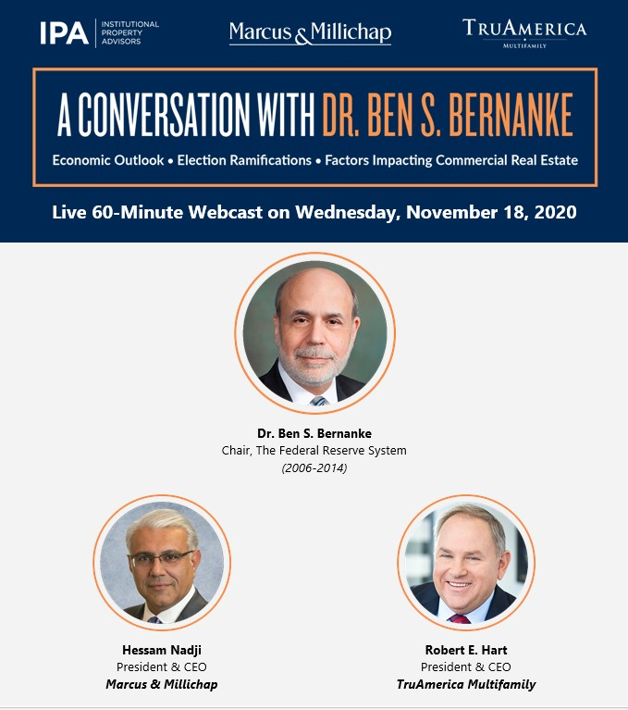
What impact will the election results have on real estate investors?
Election Outcome Remains Uncertain
  While election results are not yet final, the likely outcome will be a divided Congress with Biden as president
  A split government is unlikely to enact significant reforms and may only pass a moderate stimulus package
Interest Rates Will Likely Remain at Record Lows
  A moderately sized stimulus package will put pressure on the Federal Reserve to keep interest rates low
  Exceptionally low interest rates and solid cap rates have created some of the widest yield spreads on record
  If financing liquidity remains strong, as has been for most property types, the outlook will be favorable for investors
Positive Long-Term Drivers of CRE Sustain Outlook
  While questions on taxes and 1031-exchanges remain, a split government lowers future possible risks
  Overall, reduced uncertainty, a second federal stimulus, and low interest create a favorable climate for investors
Dr. Bernanke Shares His Insights on the Election, CRE, and More!

